Slide 1

Join today at www.aapg.org.

Slide 2

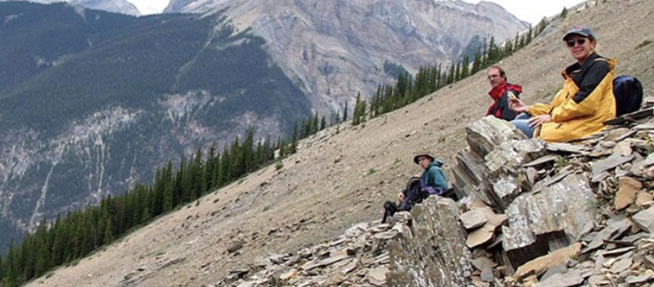
Your Network of Professional Excellence
Geologists
Geophysicists
Engineers
CEOs
Managers
Consultants
Academicians
Students
Legacy
Executive Level
Mid-Career
Young
Professionals
Students
AAPG members are with you each step of
your professional career path.

Slide 3
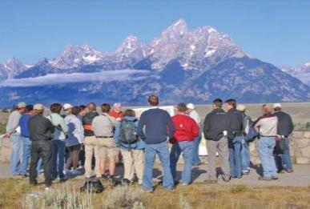
Networking and Information are the key elements that help AAPG unlock member and industry opportunities.
Membership Advantages
Bulletin, Interpretation and Explorer
Datapages, Search and Discovery
Website, AAPG Wiki
ACE, ICE, URTeC
IPAA, GEO, Super Basins
GTWs, Hedbergs, Playmakers
Section, Region and Society Support
Short Courses
Field Trips and Conferences
Join today at www.aapg.org.

Slide 4

AAPG has a proud past and an unlimited future!
How will YOU advance the science?
Join today at www.aapg.org.

Slide 5

Supplemental Slides
Join today at www.aapg.org.

Slide 6
Becoming an AAPG member is EASY!
Applications are available online for Member, Associate
and Student levels.
Annual dues are based on each individual’s personal gross income.
Those earning $50,000 or more, pay $125.
Those earning less than $50,000, save 50 percent.
Those earning less than $25,000, save 75 percent.
Student fees are $10 per year ( no cost with Chevron-sponsored grant).
No sponsor is required and member benefits are generally accessible within five days.
Join today at www.aapg.org.

Slide 7
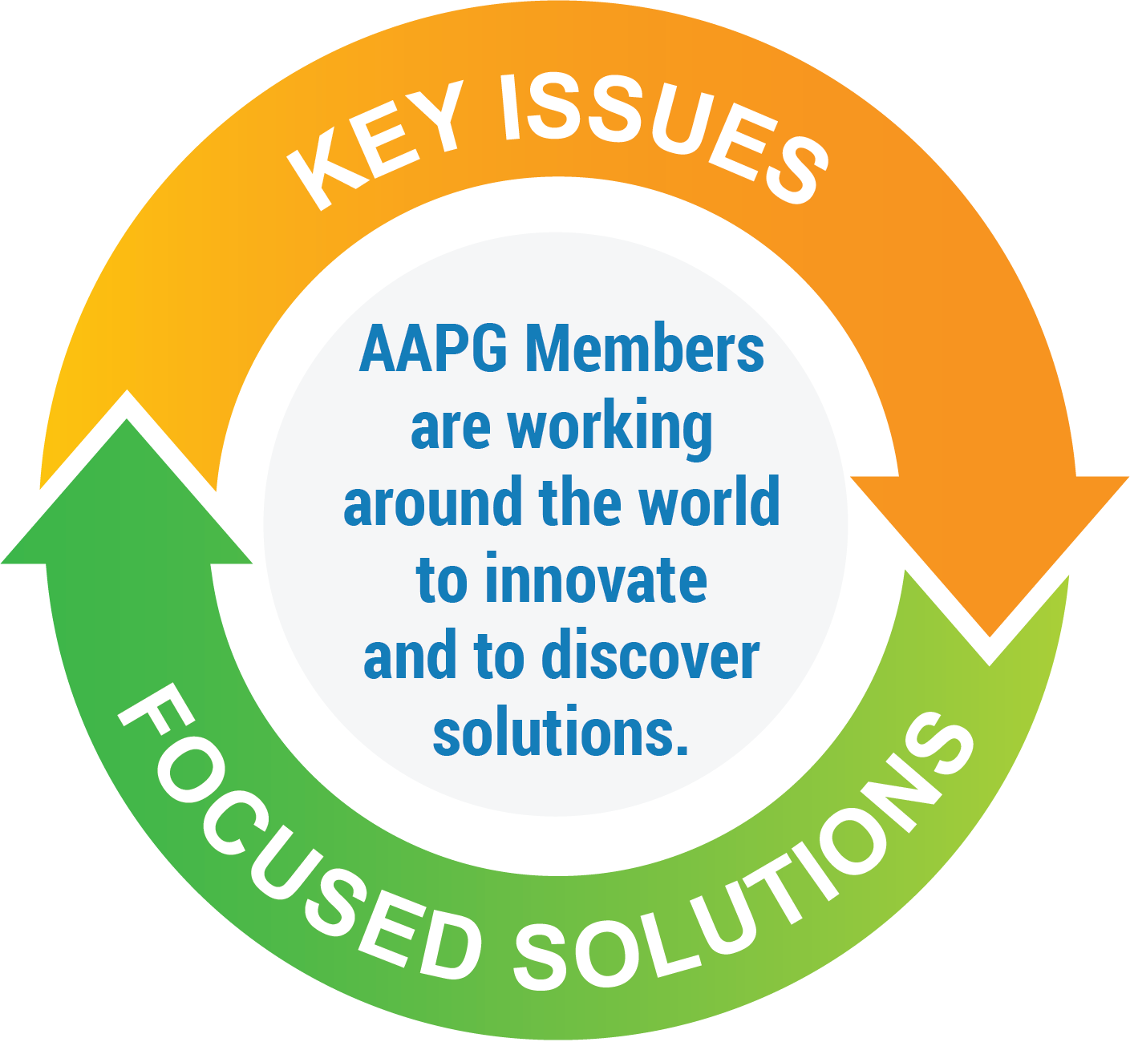
OUTSIDE
INFLUENCES
Jobs
Student
Support
Future
Exploration
U.S. Resource Explosion
Networking
Sustainability/
Carbon Capture
Oil and Gas
Investment
Mentoring
Climate
Change
Politics
Renewable
Energy
Disseminate
Science
Conventional
Depletion
Technology
Reservoir
Evaluation
GeoAnalytics
Commodity
Prices
Strat-
GeoSteering
Petrophysics,
Geochemistry
Join us today at www.aapg.org.

